Slide 1
welcome all the teachers

Slide 2
Brainstorming
Write the date
of some important
days

Slide 3




Teacher’s day

Slide 4
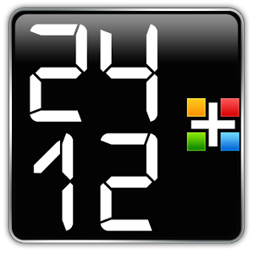
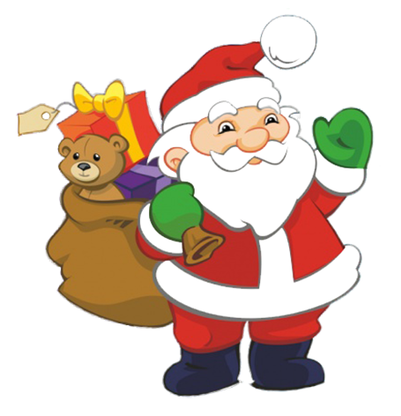
Christmas

Slide 5
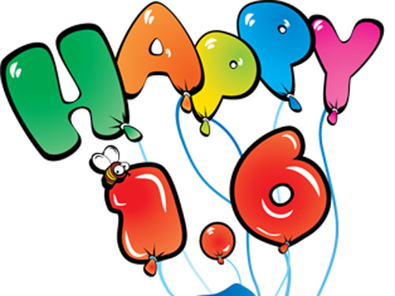
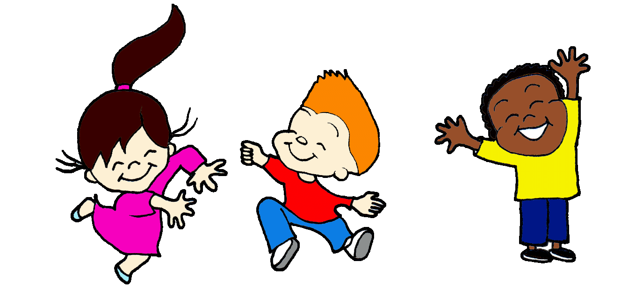
Children’s day

Slide 6

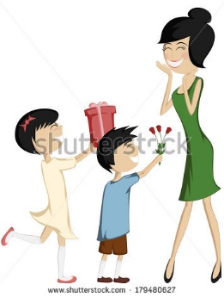
Mother’s day

Slide 7
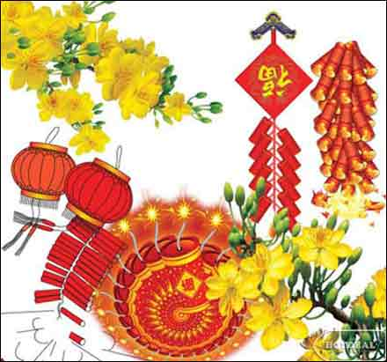
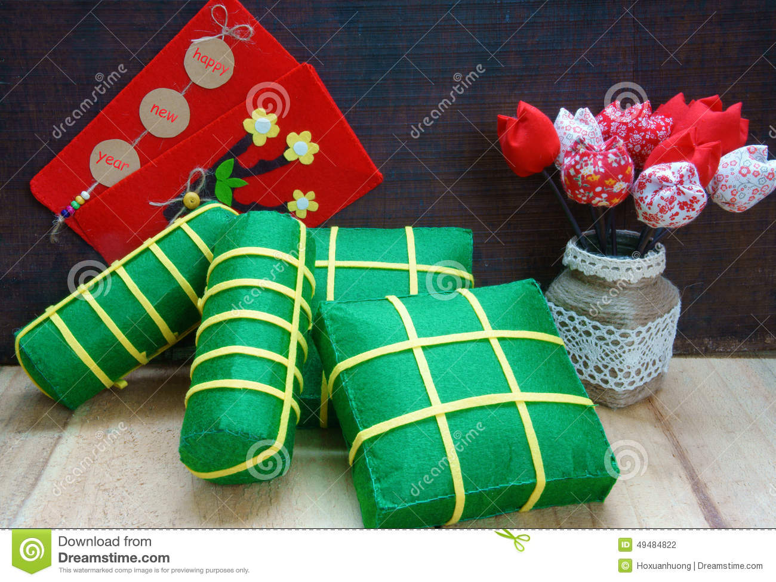
New Year’s Eve

Slide 8
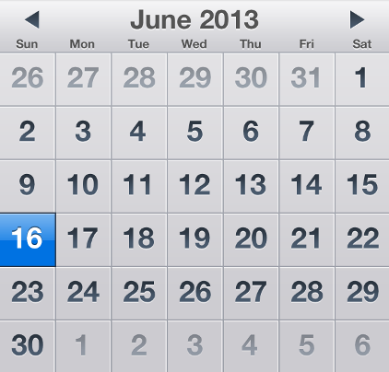

Father’s day

Slide 9


Valentine’s day

Slide 10



International women’s day

Slide 11
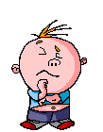

UNIT 7 : THE WORLD OF WORK
Lesson 2: A2

Slide 12

* Vocabulary:
Unit 7: THE WORLD OF WORK
Lesson 2: A2
A. A student’s work
A2. Read.Then answer the question.
‘
Independence Day (n)
Christmas ( n)
Easter ( n)
New Year’s Eve (n)
Thanksgiving (n)
: ngày Quốc Khánh
: lễ Giáng Sinh
: lễ Phục Sinh
: đêm giao thừa
: lễ Tạ Ơn
‘
‘
‘

Slide 13

What and Where
1
2
3
Easter
Christmas
Thanksgiving
4
Independence Day
5
New Year’s Eve

Slide 14



Slide 15

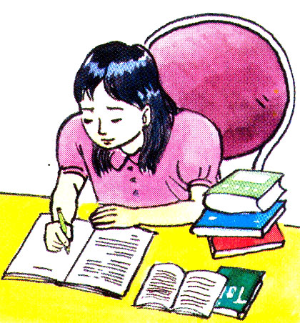
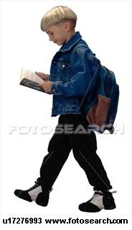
VIET NAM
AMERICA
HOA
TIM

Slide 16
* True / False statements :
Vietnamese students have fewer vacations than American students.
American students have the longest vacation in the winter.
They don’t have Tet holiday.
Their most important vacation is New Year’s Day.
5. They usually spend their time with families on Christmas and Thanksgiving holidays.

Slide 17

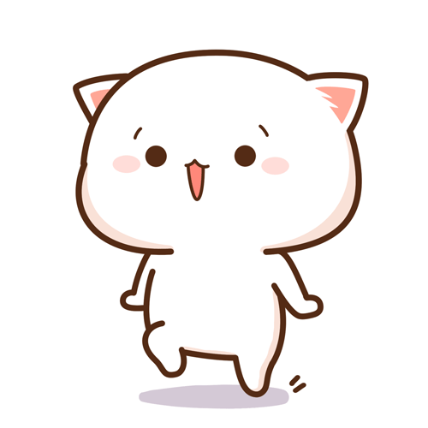
A letter from America
June 1
Dear Hoa,
Hi! How are you? I'm fine. Thanks for your letter. I like hearing about how students live in Viet Nam. I find it really interesting
I think you have fewer vacations than American students. Is that true? Our longest vacation is in the summer. Do you have a long summer vacation, too? We don't have a Tet holiday, but we celebrate the New Year on January 1. Our most important vacations are Easter, 4th of July, Thanksgiving and Christmas. We usually spend time with our families on these vacations.
What other vacations do you have? What do you like doing during your vacations? Please write soon and tell me.
Your friend,
Tim

Slide 18
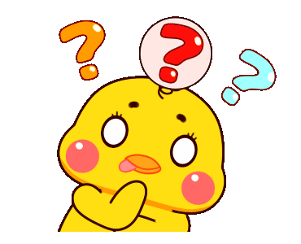
*Checking True / False:
True
1. Vietnamese students have fewer vacations than American students.
False
2. American students have the longest vacation in the winter.
summer
True
3. They don’t have Tet holiday.
False
4. Their most important vacation
is New Year’s Day.
are Easter, 4th of July, Thanksgiving and Christmas
True
5. They usually spend their time with families on Christmas and Thanksgiving holidays.

Slide 19
* ANSWER THE QUESTIONS
1. Which American vacation is the longest?
2. Does Tim have a Tet holiday?
3. What is the longest vacation for Vietnamese students?
4. What does Tim do during his vacation?
5. What do you usually do in summer?
6. Which holiday do they celebrate on December 25th ?
7. Do Vietnamese students have more or fewer vacations than American ones?

Slide 20




FLOWER- PICKING
QUESTION 4 |  | QUESTION 1 | QUESTION 5
 |  |  | QUESTION 7
QUESTION 2 |  | QUESTION 6 | QUESTION 3
1
2
3
4
5
6
7
8
9
10
11
12
Group A
2
2
2
2
2
2
2
2
Group B
2
2
2
2
2
2
2
2

Slide 21

        Which American vacation is the longest?
Summer vacation is the longest in America .

Slide 22


Does Tim have a Tet holiday?
No, he doesn’t

Slide 23


        What is the longest vacation for Vietnamese students ?
The longest vacation for Vietnamese students is summer vacation .

Slide 24


What does Tim do during his vacation?
During his vacation, Tim spends time with his family.

Slide 25

What do you usually do in summer?

Slide 26

        Which holiday do they celebrate on December 25th ?
It is Christmas

Slide 27


Do Vietnamese students have more or fewer vacations than American ones?
Vietnamese students have fewer vacations than American students.

Slide 28
*Answer key for the questions
a. Summer vacation is the longest in America.
b. During his vacation, Tim spends time with his family.
c. Vietnamese students have fewer vacations than American students.

Slide 29
* Vocabulary:
Unit 7: THE WORLD OF WORK
Lesson 2: A2-3
A. A student’s work
A2. Read.Then answer the question.
* True /False statements
* Answer the questions:
A3. Listen. Write the name of the public holiday.
* Ordering pictures:

Slide 30
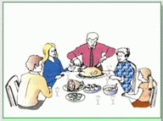

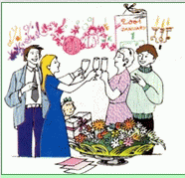
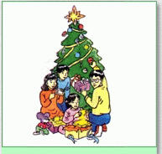
* ORDERING PICTURES
a
b
c
d
1- ; 2- ; 3- ; 4-
d
a
b
c

Slide 31
* LISTEN AND WRITE THE NAME OF THE PUBLIC HOLIDAY.
a
b
THANKSGIVING
INDEPENDENCE DAY
d
c
d
c
c
NEW YEAR’S EVE
CHRISTMAS

Slide 32


*MATCH THE HOLIDAY WITH THE TIME
Easter
Christmas
New Year’s Day
Hung Vuong anniversary.
Tet holiday
Thanksgiving.
Vietnamese Independence Day
American Independence Day
1st of January
Lunar 10th of March
Late March or early April
2nd of September
The fourth Thursday of November
4th of July
Lunar 1st of January
25th of December
1+ ; 2+ ; 3+ ; 4+ ; 5+ ; 6 + ; 7+ 8+
c
h
a
b
g
e
d
f

Slide 33
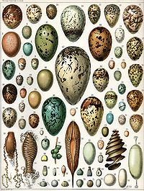
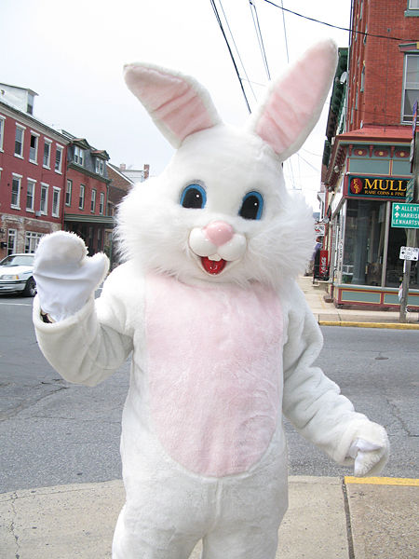
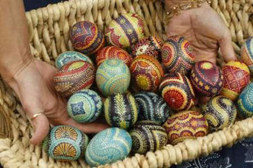
SOME PICTURES ABOUT EASTER
EASTER EGGS
EASTER BUNNY

Slide 34
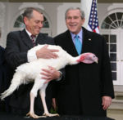
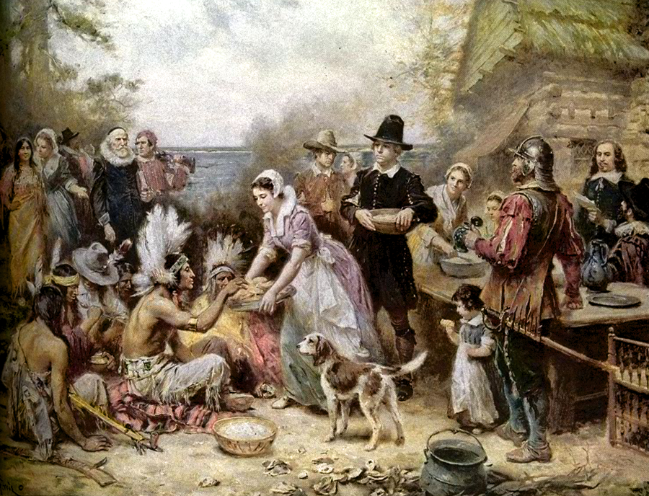
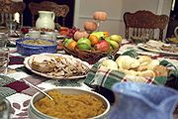
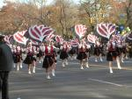
SOME PICTURES ABOUT THANKSGIVING

Slide 35
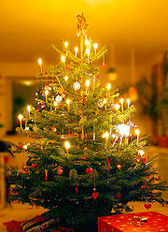

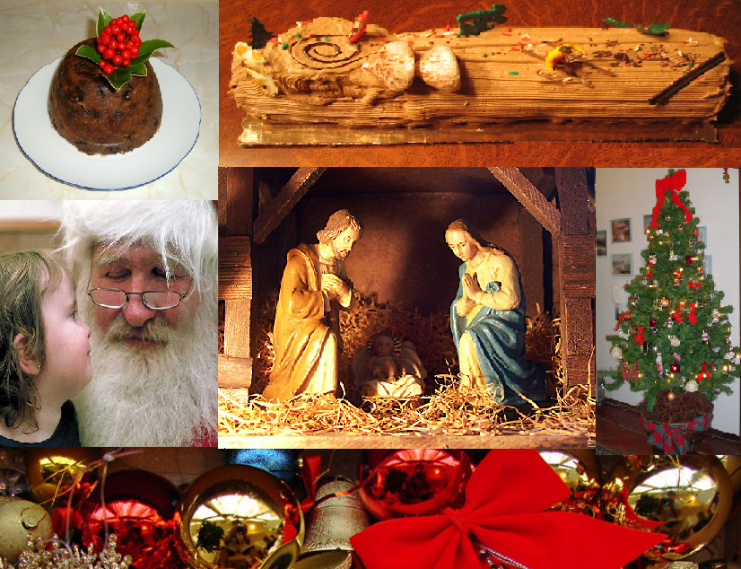
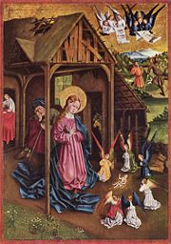
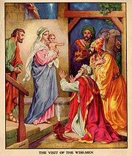
SOME PICTURES ABOUT CHRISTMAS

Slide 36
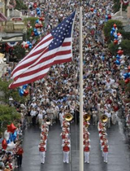
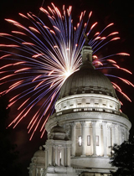
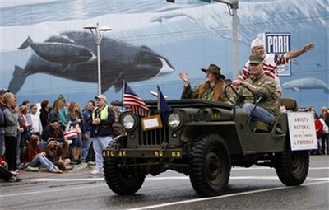
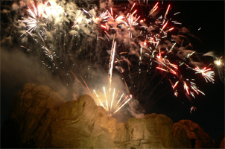
SOME PICTURES ABOUT THE INDEPENDENCE DAY IN AMERICA.

Slide 37
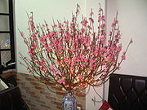
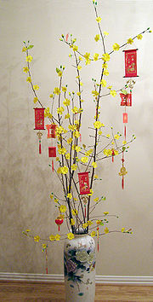
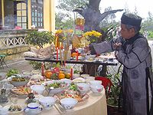
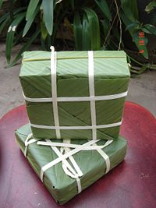
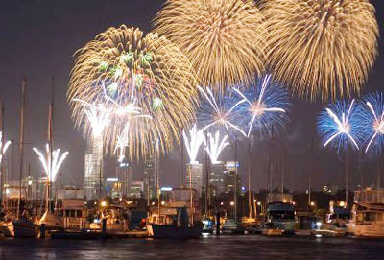
SOME PICTURES ABOUT TET IN VIET NAM.

Slide 38
* DISCUSSION
Unit 7: THE WORLD OF WORK
Lesson 2: A2-3
* What do you usually buy for Tet holiday?
* What do you usually do on Tet holiday?

Slide 39


* HOMEWORK
Learn new words by heart.
Read the letter and do the exercises again.
Do the exercises in work book.
Prepare part A4:
- Find out the new words.
- Answer the questions.

Slide 40



Thank you
Goodbye!

